Slide 1
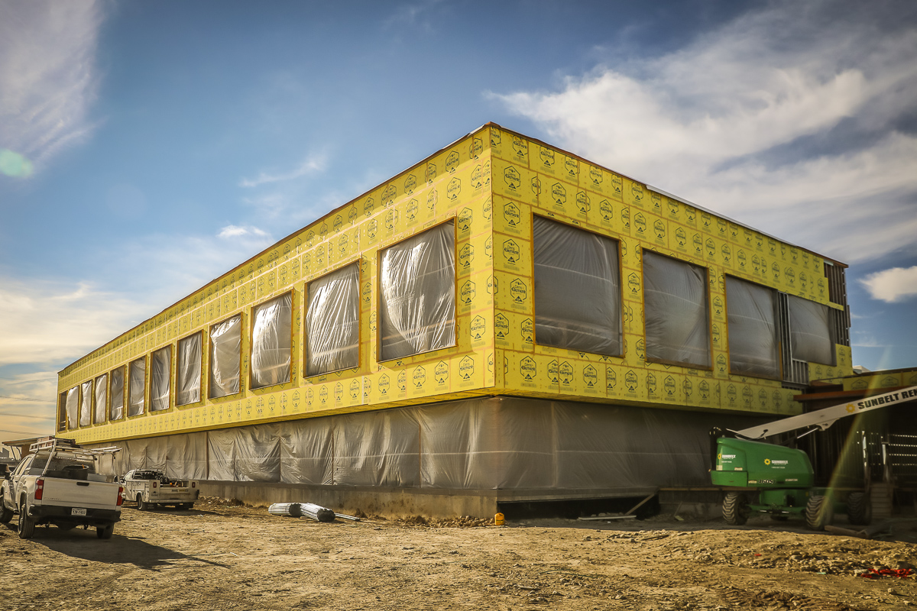
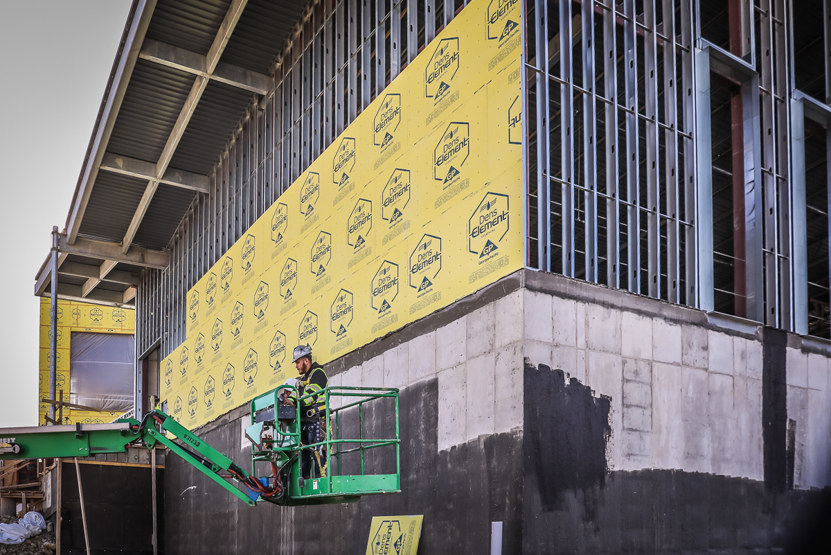
NEW ADMINISTRATION BUILDING
Exterior sheathing is being installed in the Ramsey area and the board room.

Slide 2
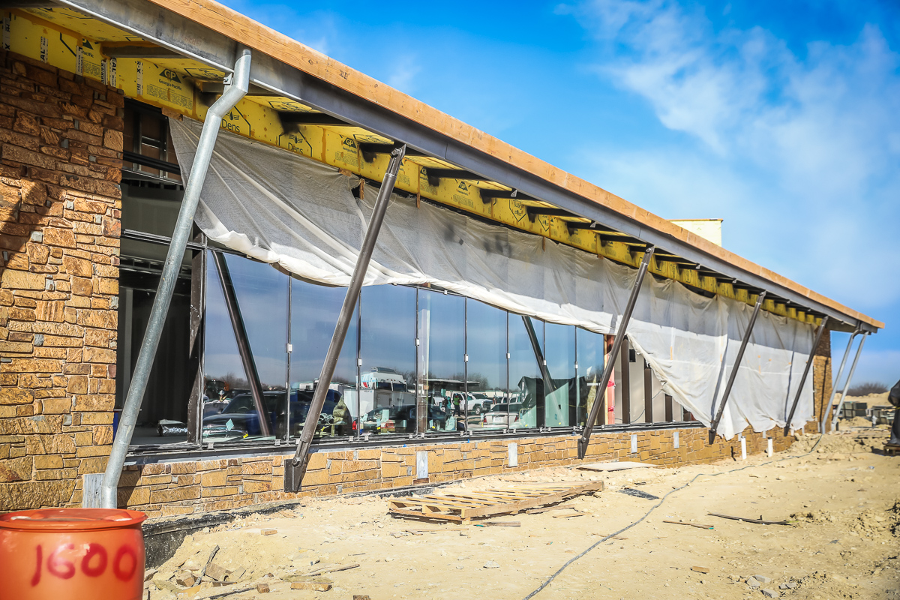
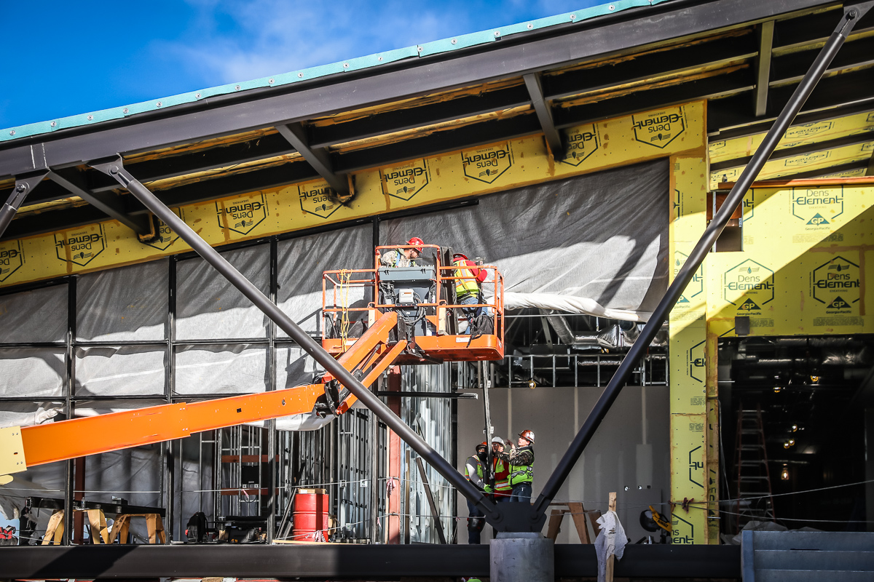
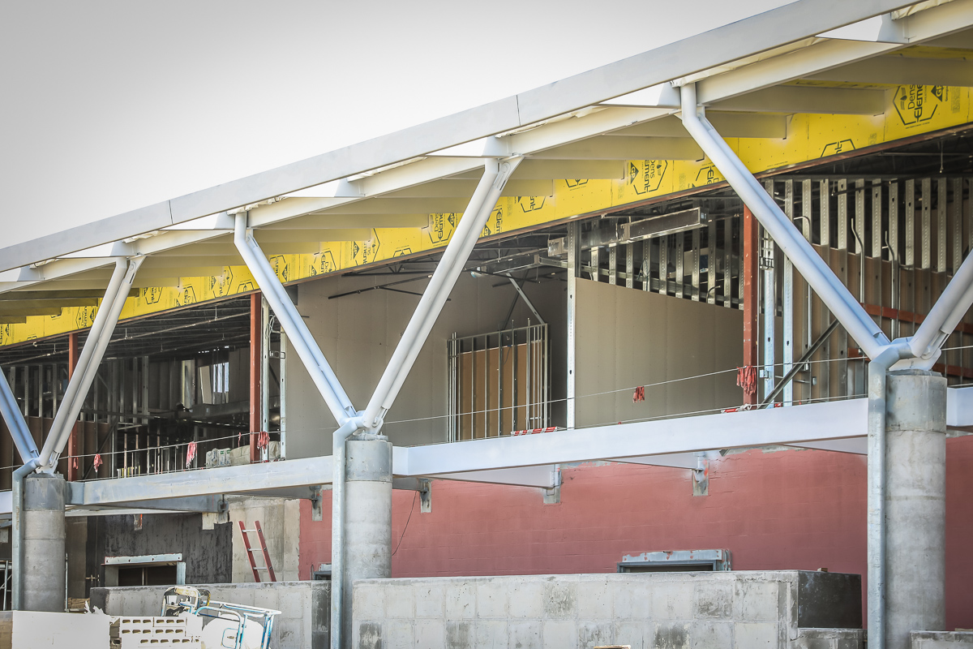
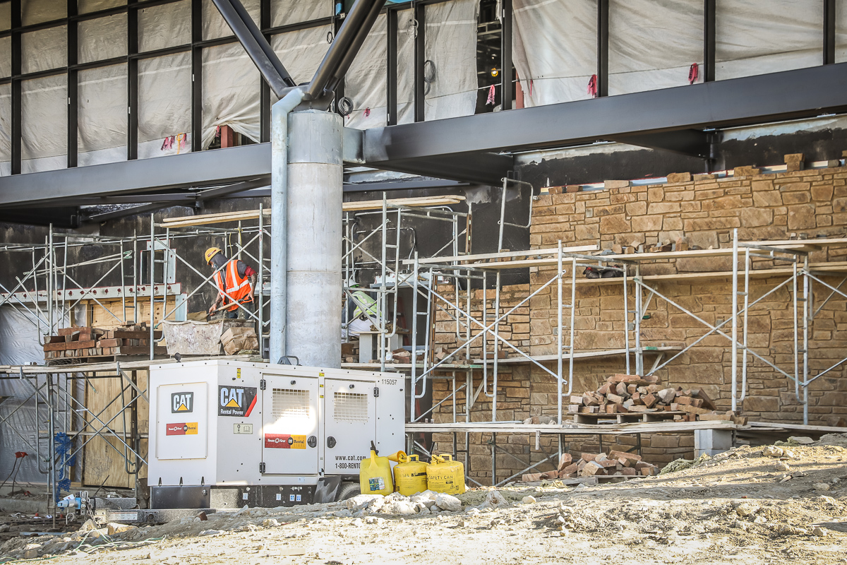
Glass frames and glass are being installed in the Absher area. Rock and sheetrock continue on the back of the building.

Slide 3
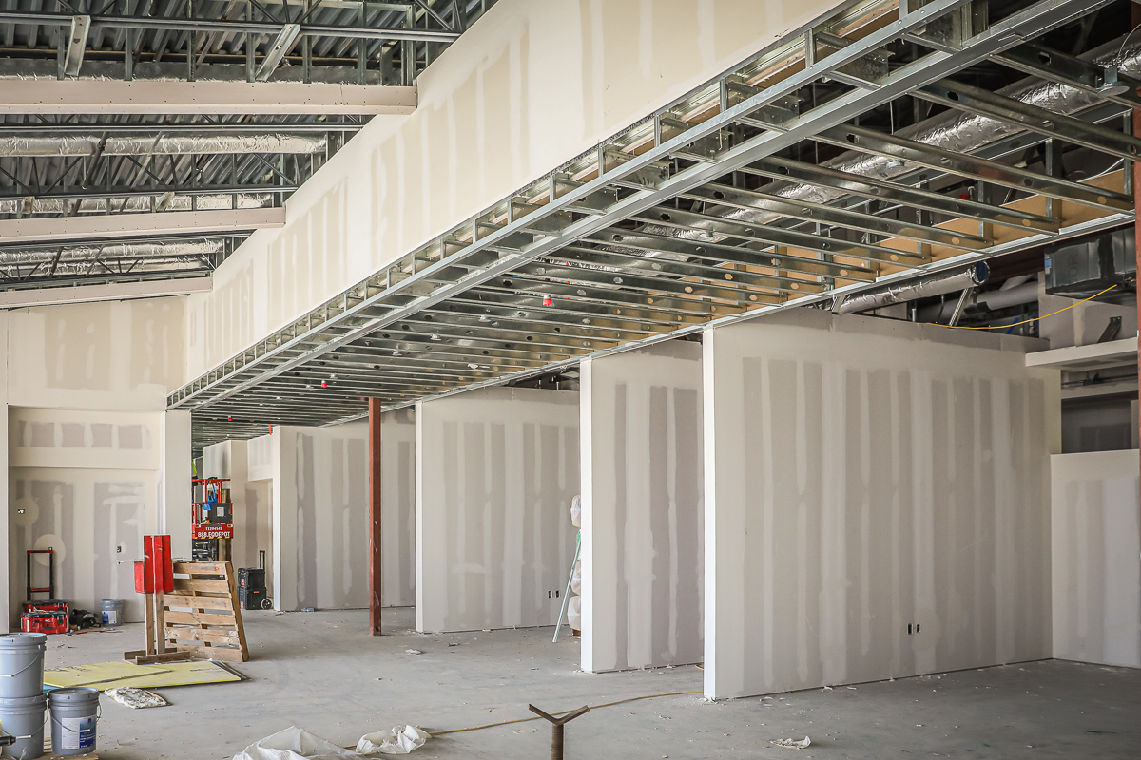
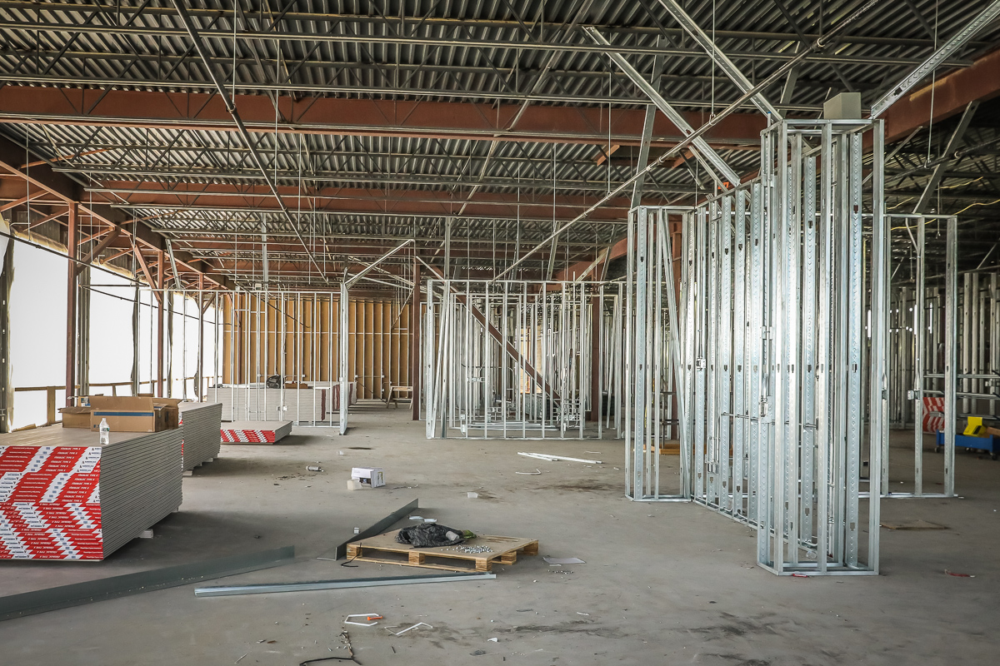
Framing and sheetrock continue in the Ramsey area.

Slide 4
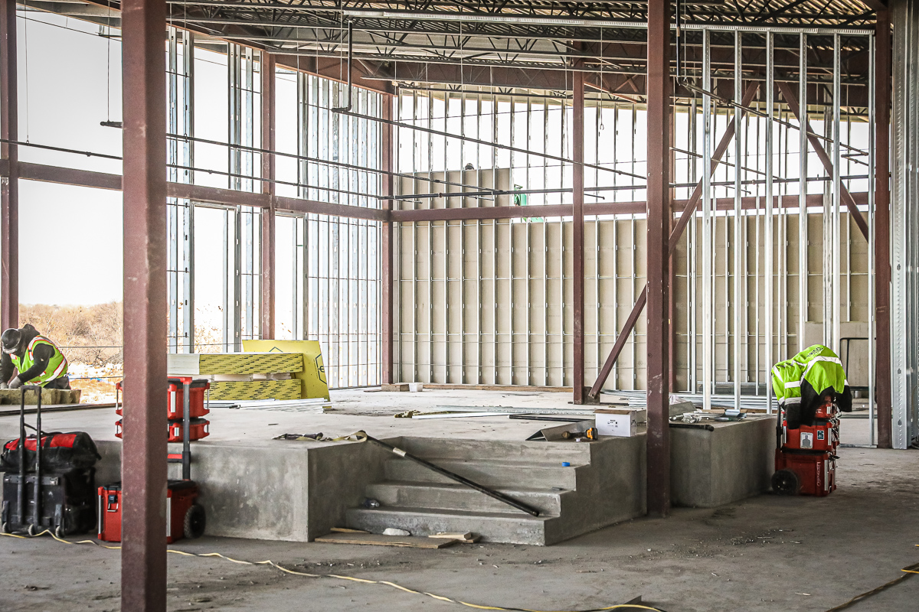
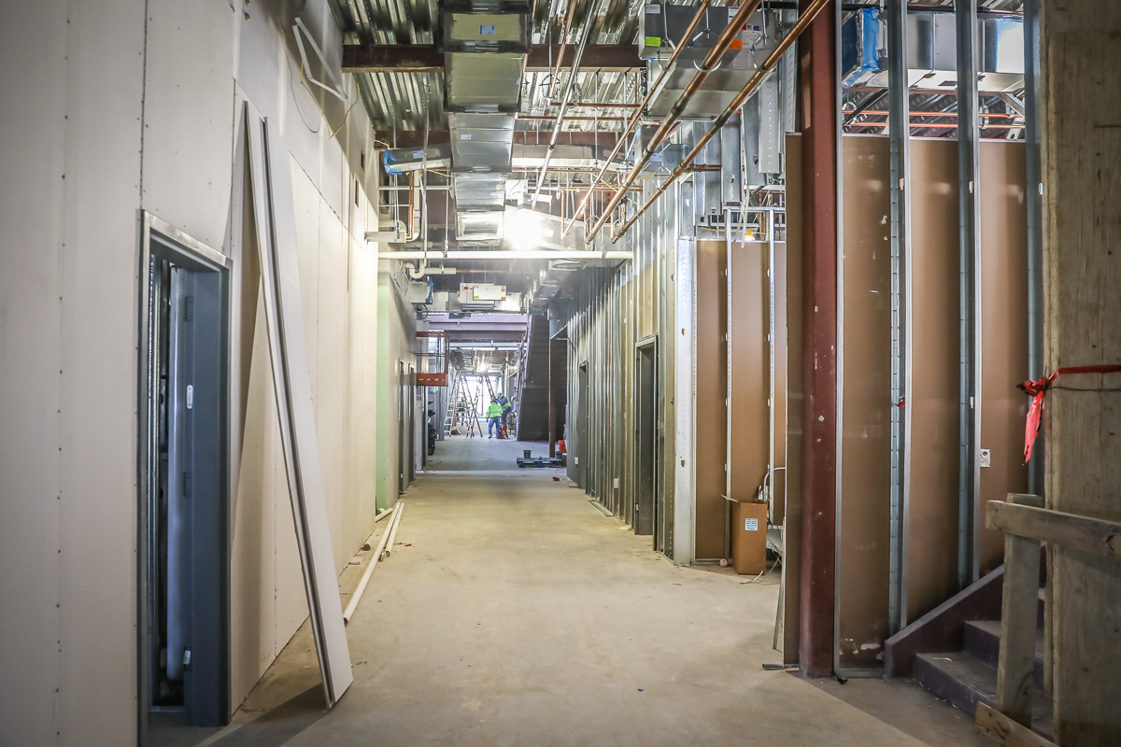
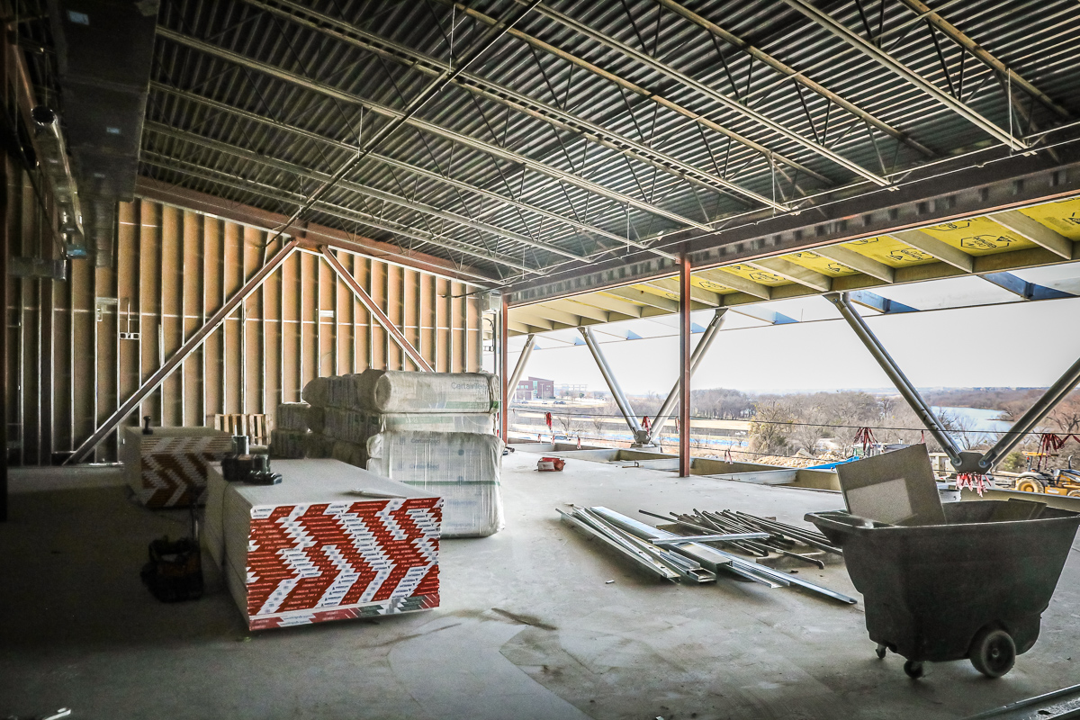
Board room dais structure has been poured.
Framing and sheetrock continue in the Ramsey area.

Slide 5
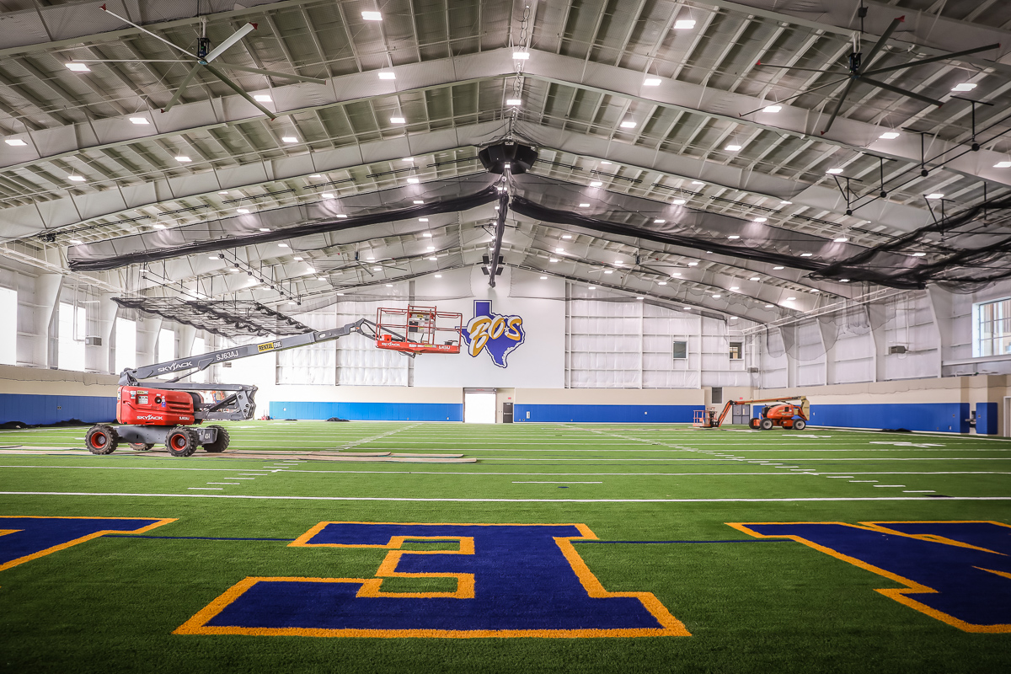
BOSWELL HS
Netting installation and punch items continue in the turf room.

Slide 6
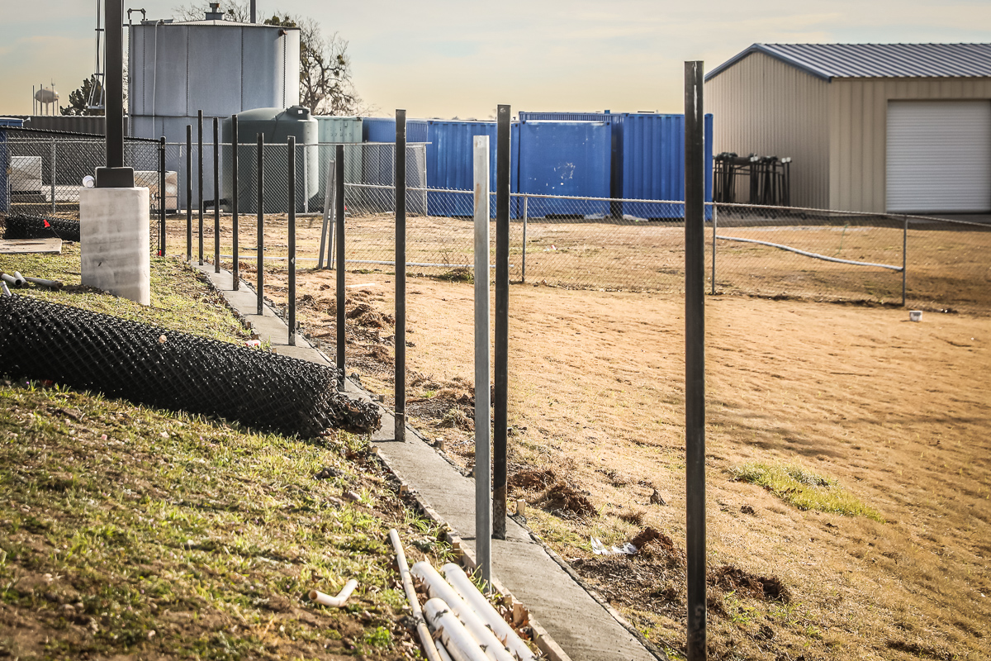
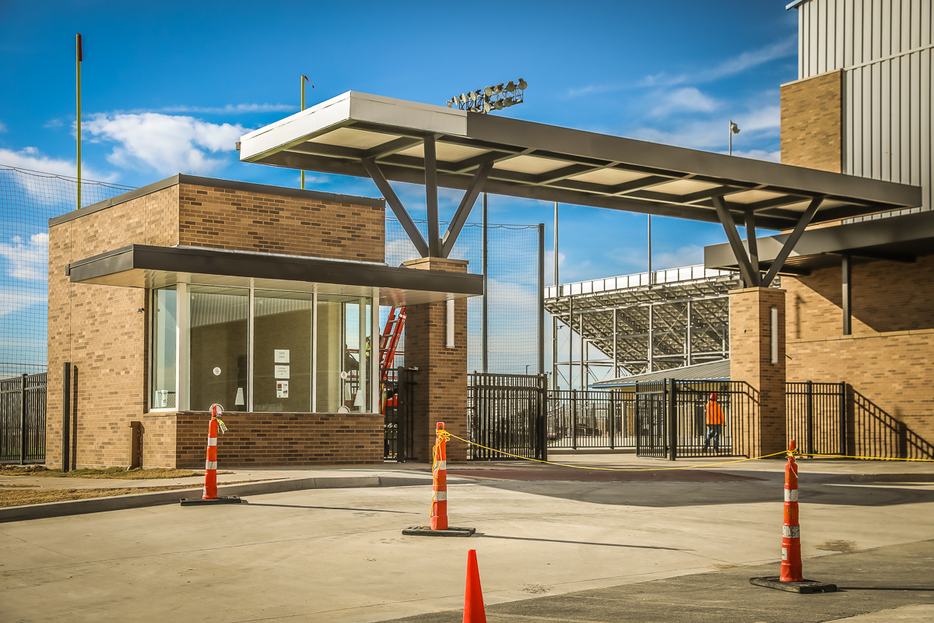
Fence and mow strip are being completed next to the softball area. Visitor ticket booth is near completion.

